Slide 1
SURVEY ON PRIVACY PRESERVING CLOUD AUDITING FOR SHARED DATA
Group members:-
Vinita Wadhwa (70)
Ria Wadhwani (71)
Vinita Wadhwani (72)

Slide 2
ABSTRACT:
Cloud is a type of platform which helps to store the data as well as helps in sharing the data. While sharing the huge amount of data, the primary concern comes in mind is data integrity, security of the data. For the cloud server and the user it is not possible to check the integrity, consistency of stored data on cloud. Public Auditing method can help to overcome this problem. Hence the user takes help of the third party auditor (TPA) for auditing their data. Many of the techniques have been proposed by various researchers which improve upon one another. Here we have presented three landmark methodologies on Privacy preserving cloud auditing for shared data on cloud.

Slide 3
INTRODUCTION
Cloud Computing is an upcoming new technology which provides the on-demand facility of a shared pool of resources (computing resources) (e.g., computer storage, applications and other resources), which can include rapid allocation and freedom with minimum number of efforts. Cloud computing and storage solutions provide individual users and companies with variety of capabilities to store and work on their data in data centers which are not owned by them and the location may be remote, may be across a city or across continents. Cloud computing provides sharing of resources to achieve economy of scales. The users use this cloud for sharing and the collaboration of their data with many other users in the group. Data sharing has become need in today’s world and it is provided in most of the cloud storage offerings, via Dropbox, Google.

Slide 4
BLOCK DIAGRAM

Slide 5
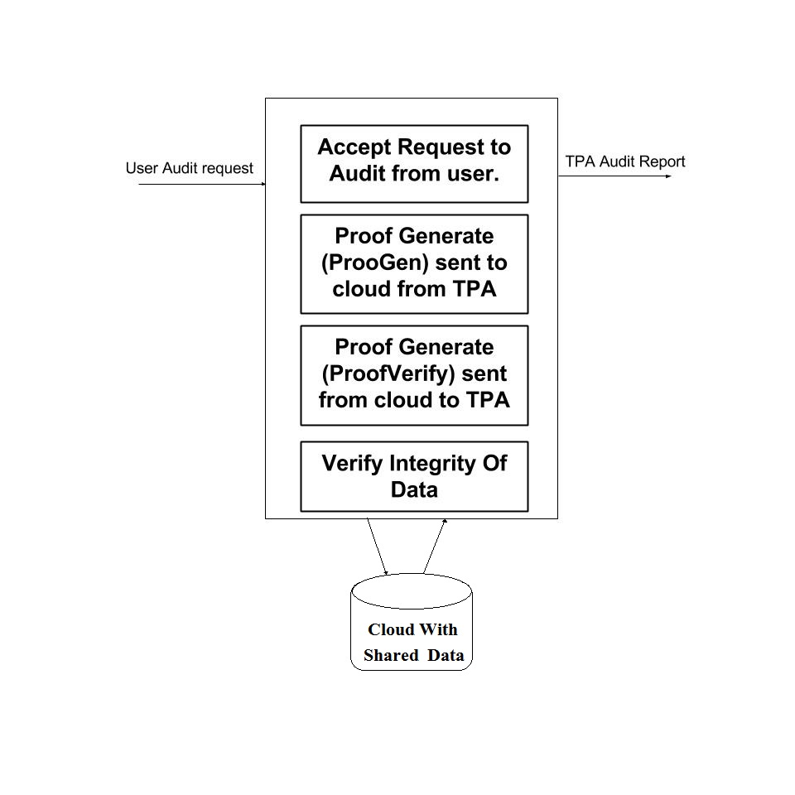

Slide 6
SNAPSHOTS

Slide 7
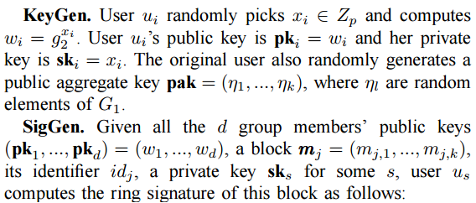
KEYGEN ALGO

Slide 8
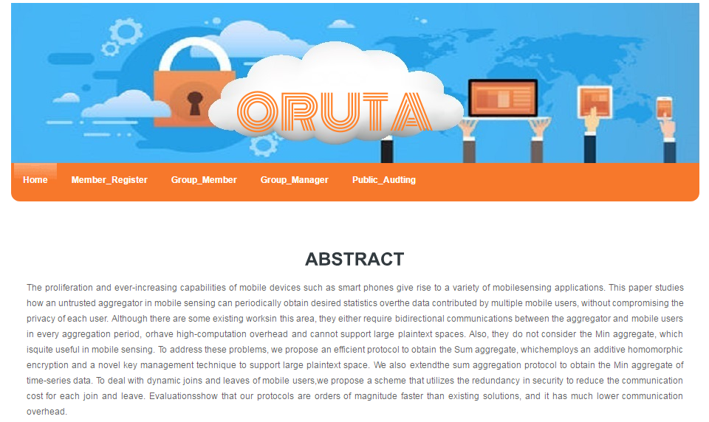

Slide 9
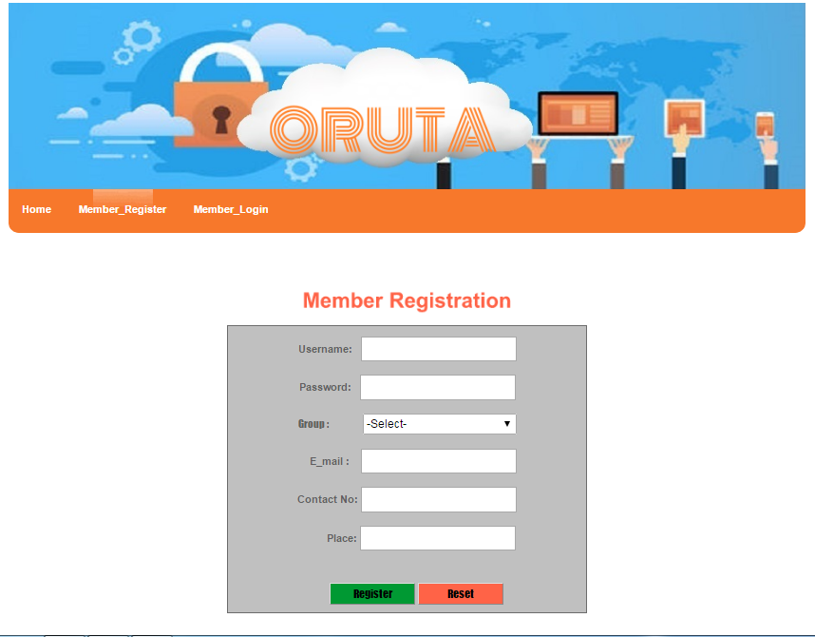

Slide 10
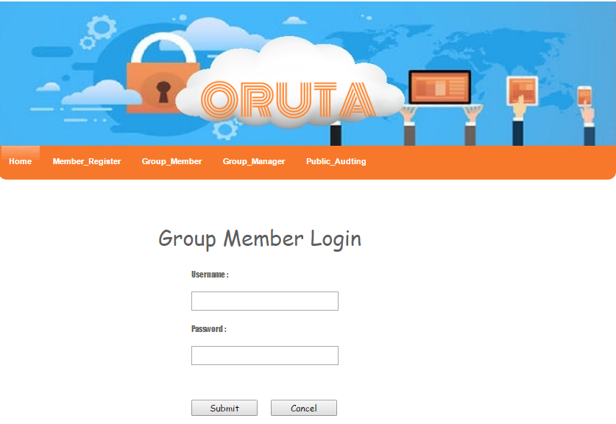

Slide 11
Results

Slide 12
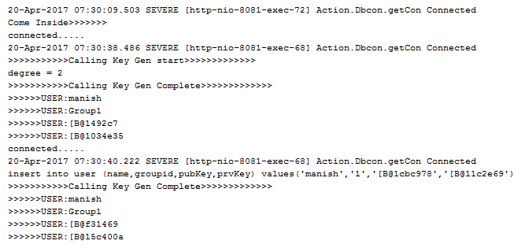

Slide 13
Conclusion
After these techniques are understood, algorithms will be given code form. But the implementation of basic UI will be started during the understanding of the techniques is going on. Netbeans is used for development as we have unanimously decided to implement Oruta in JSP, so as to increase its productivity by implementing it on web platform and also use the power of Java.

